Slide 1
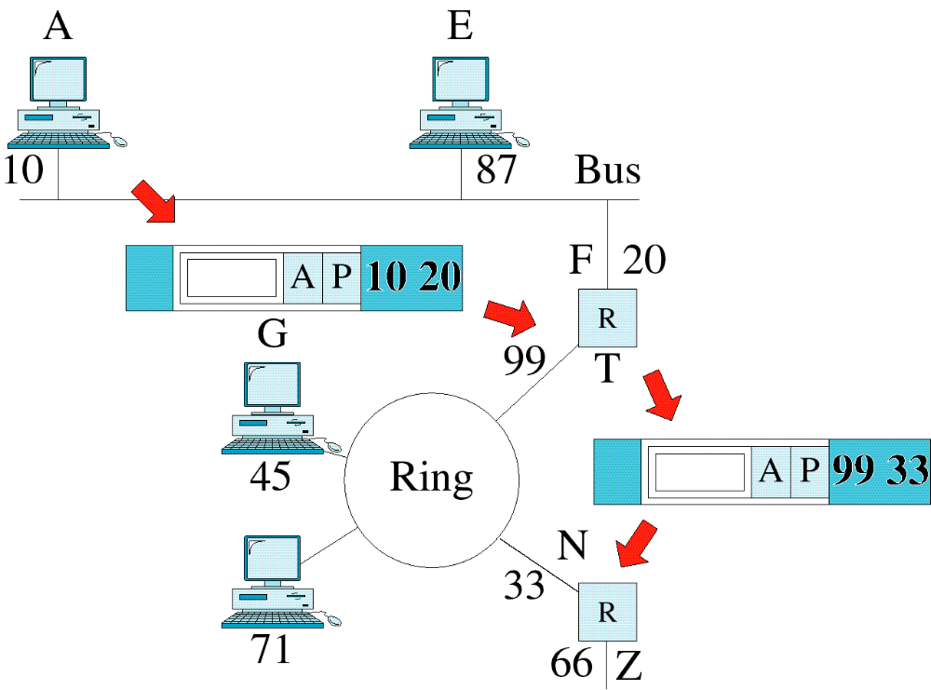
Figure 3-8
Network Layer Example
WCB/McGraw-Hill
© The McGraw-Hill Companies, Inc., 1998

Slide 2
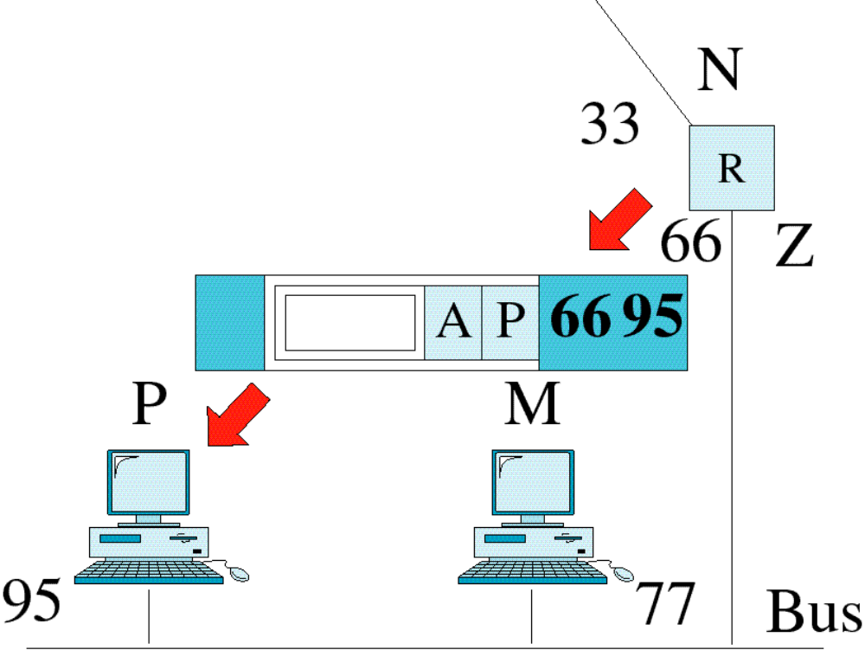
Figure 3-8-continued
Network Layer Example
WCB/McGraw-Hill
© The McGraw-Hill Companies, Inc., 1998

Slide 3
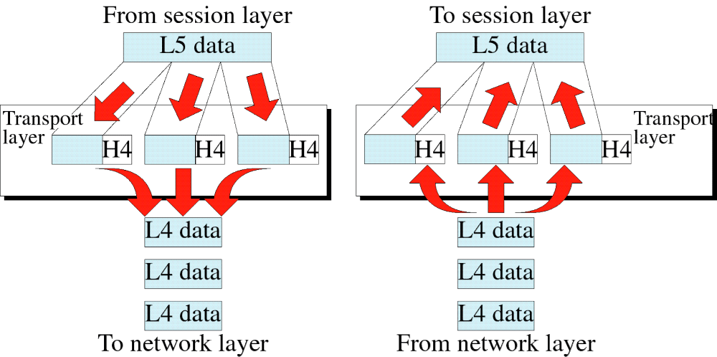
Figure 3-9
Transport Layer
WCB/McGraw-Hill
© The McGraw-Hill Companies, Inc., 1998

Slide 4
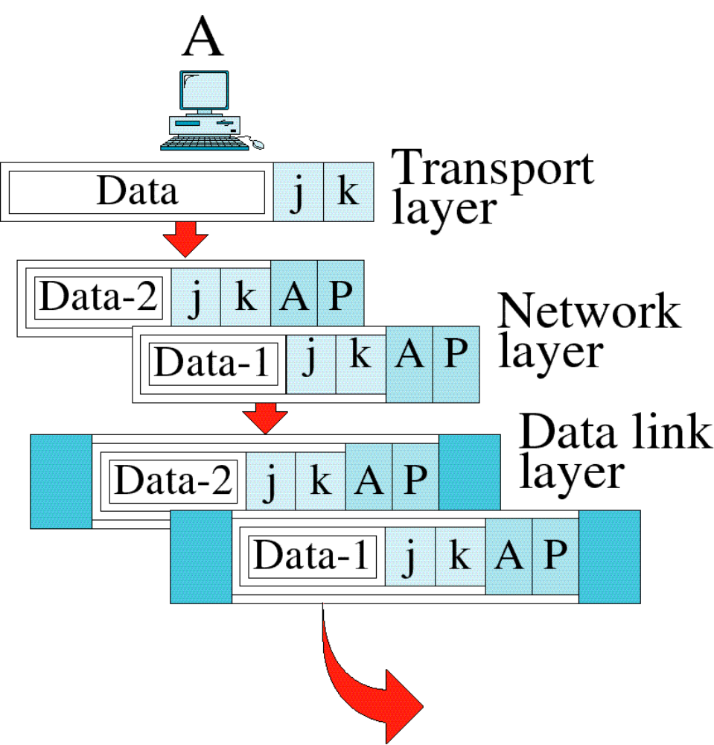
Figure 3-10
Transport Layer Example
WCB/McGraw-Hill
© The McGraw-Hill Companies, Inc., 1998

Slide 5
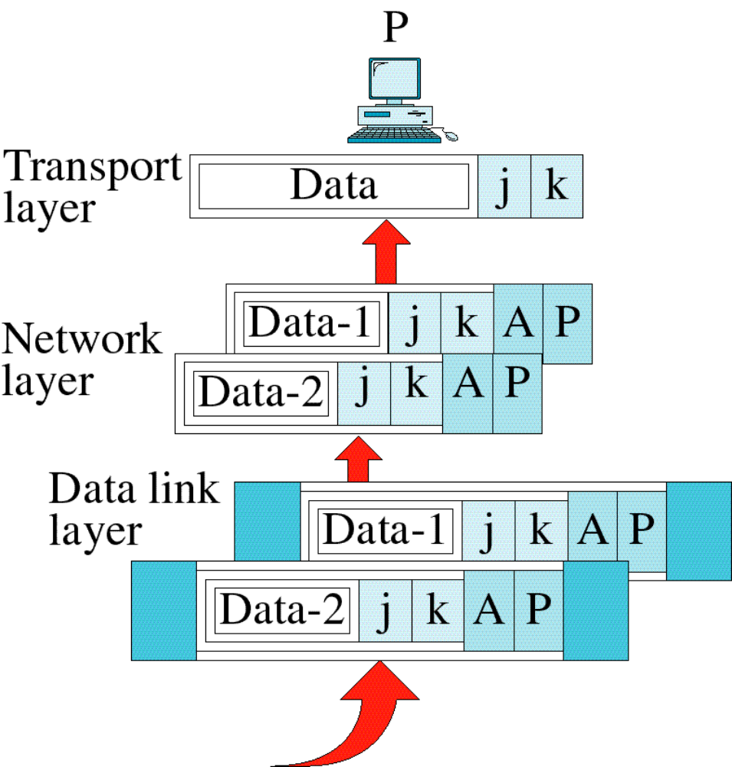
Figure 3-10-continued
Transport Layer Example
WCB/McGraw-Hill
© The McGraw-Hill Companies, Inc., 1998

Slide 6
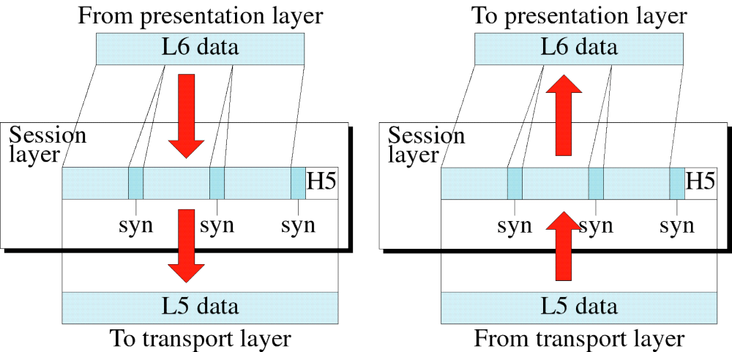
Figure 3-11
Session Layer
WCB/McGraw-Hill
© The McGraw-Hill Companies, Inc., 1998

Slide 7
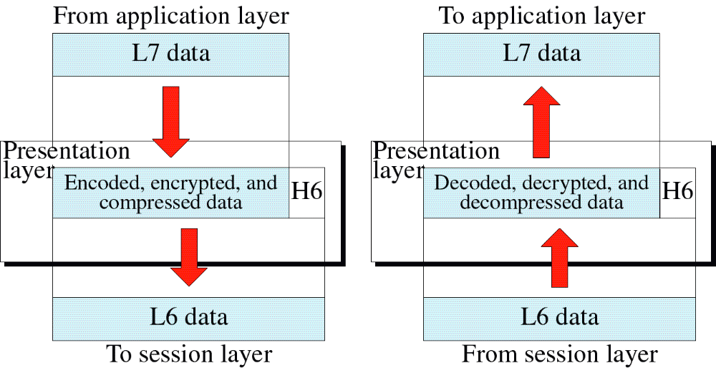
Figure 3-12
Presentation Layer
WCB/McGraw-Hill
© The McGraw-Hill Companies, Inc., 1998

Slide 8
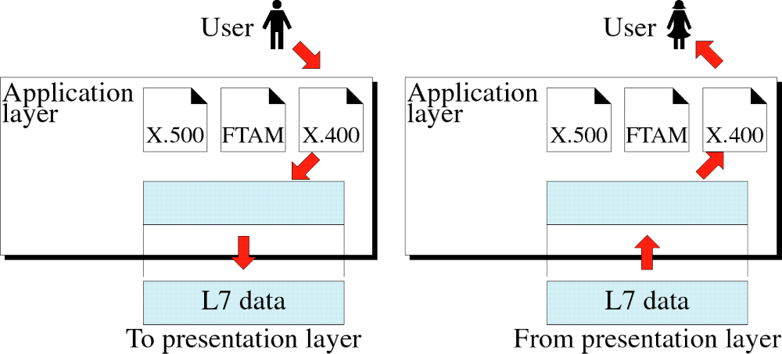
Figure 3-13
Application Layer
WCB/McGraw-Hill
© The McGraw-Hill Companies, Inc., 1998

Slide 9
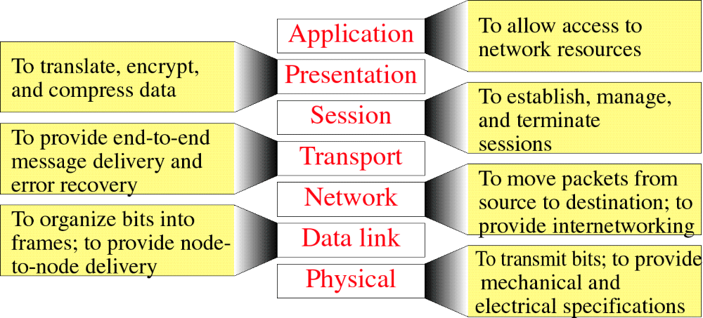
Figure 3-14
Summary of Layer Functions
WCB/McGraw-Hill
© The McGraw-Hill Companies, Inc., 1998

